Slide 1

مبانی داده کاوی
شناخت داده ها
بهشیـد بهکمـال
نیمسال اول 1400-1399

Slide 2
Know Your Data
Data Objects and Attribute Types
Basic Statistical Descriptions of Data
Measuring Data Similarity and Dissimilarity
Data Visualization
Summary

Slide 3
Types of Data Sets
Record
Relational records
Data matrix, e.g., numerical matrix
Document data: text documents: term-frequency vector
Transaction data
Graph and network
World Wide Web
Social or information networks
Molecular Structures
Ordered
Video data: sequence of images
Temporal data: time-series
Sequential Data: transaction sequences
Spatial, image and multimedia:
Spatial data: maps
Image data:
Video data:

Slide 4
Important Characteristics of Structured Data
Dimensionality
Curse of dimensionality
Sparsity
Only presence counts
Resolution
Patterns depend on the scale
Distribution
Centrality and dispersion

Slide 5
Data Objects
Data sets are made up of data objects.
A data object represents an entity.
Examples:
sales database: customers, store items, sales
medical database: patients, treatments
university database: students, professors, courses
Also called samples , examples, instances, data points, objects, tuples.
Data objects are described by attributes.
Database rows -> data objects; columns ->attributes.

Slide 6
Attributes
Attribute (or dimensions, features, variables): a data field, representing a characteristic or feature of a data object.
E.g., customer _ID, name, address
Types:
Nominal
Ordinal
Binary
Numeric: quantitative
Interval-scaled
Ratio-scaled

Slide 7
Attribute Types
Nominal: categories, states, or “names of things”
Hair_color = {auburn, black, blond, brown, grey, red, white}
marital status, occupation, ID numbers, zip codes
Ordinal
Values have a meaningful order (ranking) but magnitude between successive values is not known.
Size = {small, medium, large}, grades, army rankings

Slide 8
Attribute Types
Binary
Nominal attribute with only 2 states (0 and 1)
Symmetric binary: both outcomes equally important
e.g., gender
Asymmetric binary: outcomes not equally important.
e.g., medical test (positive vs. negative)
Convention: assign 1 to most important outcome
e.g., HIV positive

Slide 9
Numeric Attribute Types
Quantity (integer or real-valued)
Interval
Measured on a scale of equal-sized units
Values have order
E.g., temperature in C˚or F˚, calendar dates
No true zero-point
Ratio
Inherent zero-point
We can speak of values as being an order of magnitude larger than the unit of measurement (10 K˚ is twice as high as 5 K˚).
e.g., temperature in Kelvin, length, counts

Slide 10
Discrete vs. Continuous Attributes
Discrete Attribute
Has only a finite or countably infinite set of values
E.g. profession, or the set of words in a collection of documents
Sometimes, represented as integer variables
Continuous Attribute
Has real numbers as attribute values
E.g., temperature, height, or weight
Practically, real values can only be measured and represented using a finite number of digits
Typically represented as floating-point variables

Slide 11
Basic Statistical Descriptions of Data

Slide 12
Basic Statistical Descriptions of Data
Measuring the Central Tendency
Mean, Median, Mode
Data dispersion characteristics
median, max, min, quantiles, outliers, variance, etc.

Slide 13
Measuring the Central Tendency
Mean (algebraic measure):
Weighted arithmetic mean:
Trimmed mean
- chopping extreme values
Midrange:
- (Minimum + Maximum) /2

Slide 14
Measuring the Central Tendency
Median:
If odd number of values: middle value
Otherwise: average of the middle two values
Mode:
Value that occurs most frequently in the data
Unimodal, bimodal, trimodal
Empirical formula:

Slide 15
Example:
Values for salary (in thousands of dollars):
30, 36, 47, 50, 52, 52, 56, 60, 63, 70, 70, 110
Mean: 58
(30+36+47+50+52+52+56+60+63+70+70+110)/12
Median: 54
(52+56)/2
Mode: 52, 70
Bimodal
Midrange: 70
(30+110)/2

Slide 16
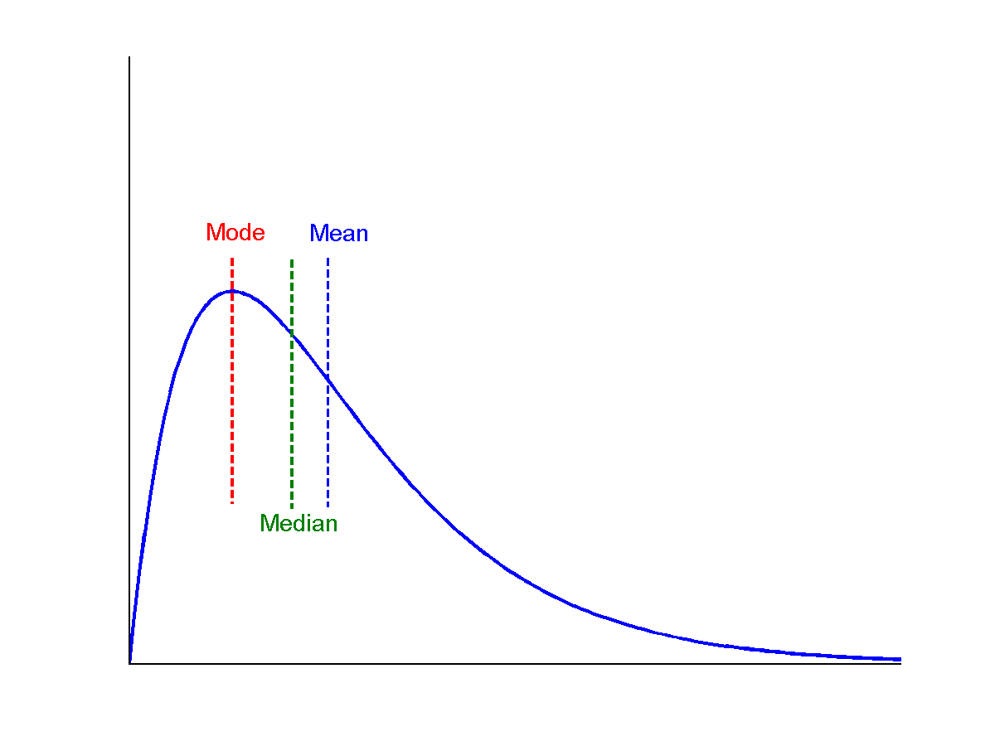
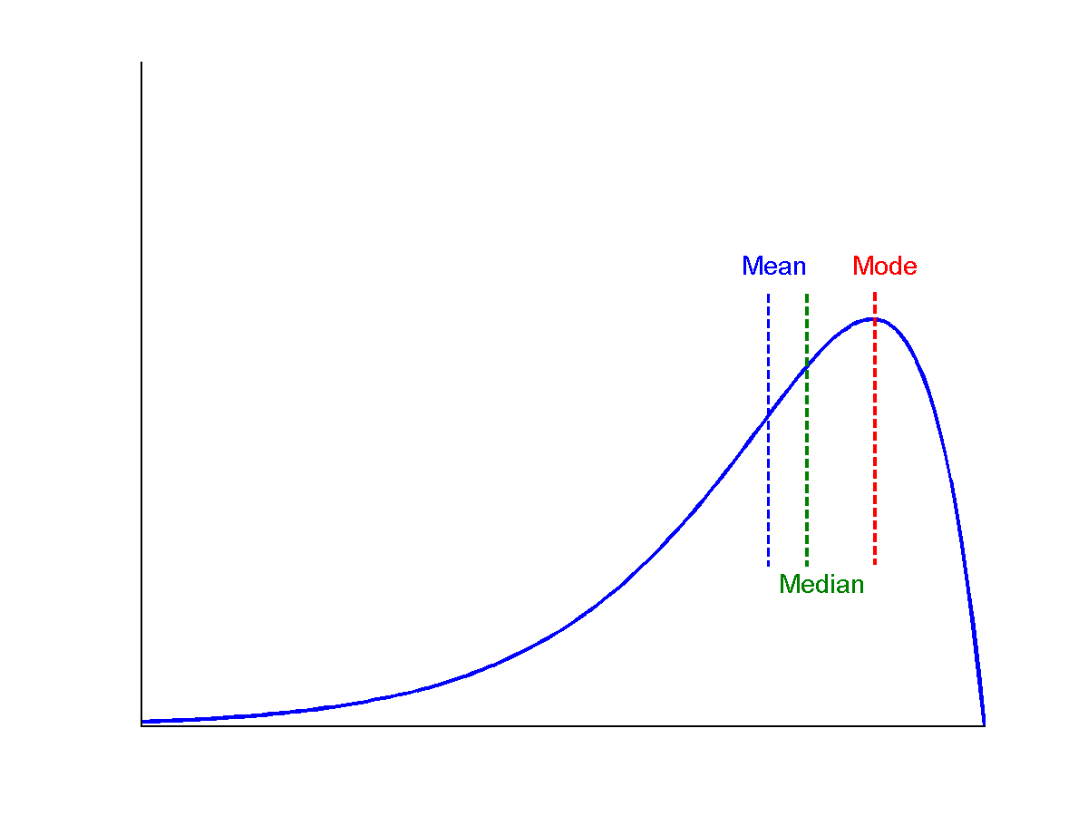
Symmetric vs. Skewed Data
symmetric
positively skewed
negatively skewed
Empirical formula for unimodal data:

Slide 17
Measuring the Dispersion of Data
Variance and standard deviation
Variance: (algebraic, scalable computation)
Standard deviation: σ is the square root of variance σ²

Slide 18
Properties of Normal Distribution Curve
μ: mean
σ: standard deviation
68%:μ–σ to μ+σ 95%: μ–2σ to μ+2σ 99.7%:μ–3σ to μ+3σ

Slide 19
Measuring the Dispersion of Data
Quartiles, outliers and boxplots
Quartiles: Q₁ (25th percentile), Q₃ (75th percentile)
Inter-quartile range: IQR = Q₃ – Q₁
Five number summary: min, Q₁, median, Q₃, max
Boxplot: ends of the box are the quartiles; median is marked; add whiskers, and plot outliers individually
Outlier: usually, a value higher/lower than 1.5 x IQR

Slide 20
Quartile and Percentile
Quartiles: Q1 (25th percentile), Q3 (75th percentile)

Slide 21
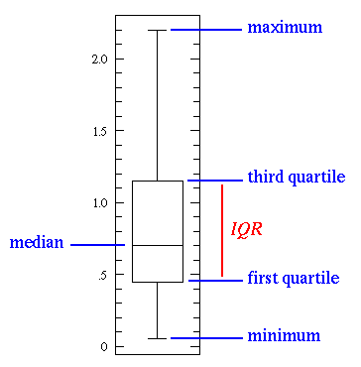
Boxplot
Inter-quartile range: IQR = Q₃ – Q₁
Five number summary: min, Q₁, median, Q₃, max

Slide 22
Boxplot …
Outlier: usually, a value higher/lower than 1.5 x IQR

Slide 23
Graphic Displays of Basic Statistical Descriptions
Boxplot
Histogram
Quantile plot
Quantile-quantile (q-q) plot
Scatter plot

Slide 24
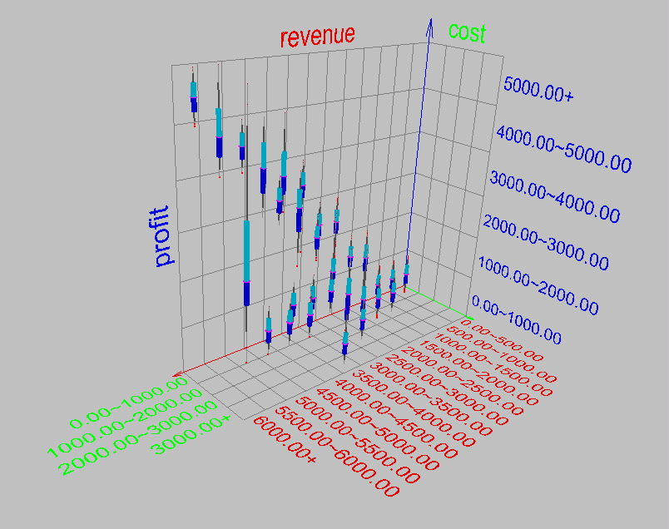
1. 3-D Boxplots

Slide 25
2. Histogram Analysis
Histogram: Graph display of tabulated frequencies, shown as bars
It shows what proportion of cases fall into each of several categories
The categories are usually specified as non-overlapping intervals of some variable.
The categories (bars) must be adjacent

Slide 26
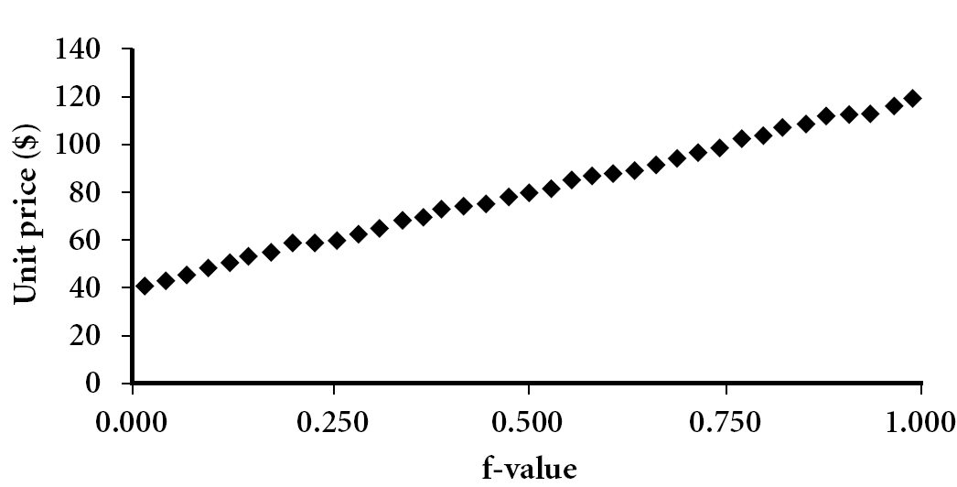
3. Quantile Plot
Displays all of the data (allowing the user to assess both the overall behavior and unusual occurrences)
Plots quantile information
For a data x_{i} data sorted in increasing order, f_{i} indicates that approximately 100 f_{i}% of the data are below or equal to the value x_{i}

Slide 27
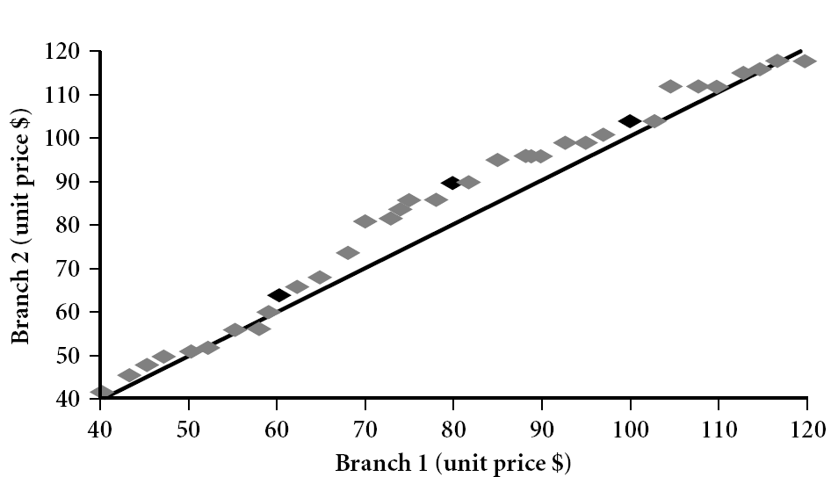
4. Quantile-Quantile (Q-Q) Plot
Graphs the quantiles of one univariate distribution against the corresponding quantiles of another
View: Is there is a shift in going from one distribution to another?
Example shows unit price of items sold at Branch 1 vs. Branch 2 for each quantile. Unit prices of items sold at Branch 1 tend to be lower than those at Branch 2.
Notes:
Note: We need to label the dark plotted points as Q1, Median, Q3 – that would help in understanding this graph.
Tell audience: There is a shift in distribution of branch 1 WRT branch 2 in that the unit prices of items sold at branch 1 tend to be lower than those at branch 2.

Slide 28
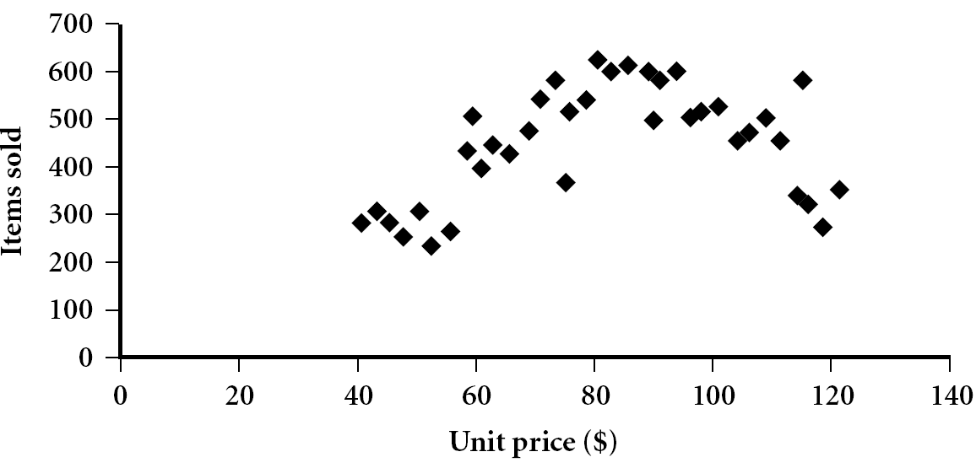
5. Scatter plot
Provides a first look at bivariate data to see clusters of points, outliers, etc
Each pair of values is treated as a pair of coordinates and plotted as points in the plane

Slide 29
Positively and Negatively Correlated Data

Slide 30
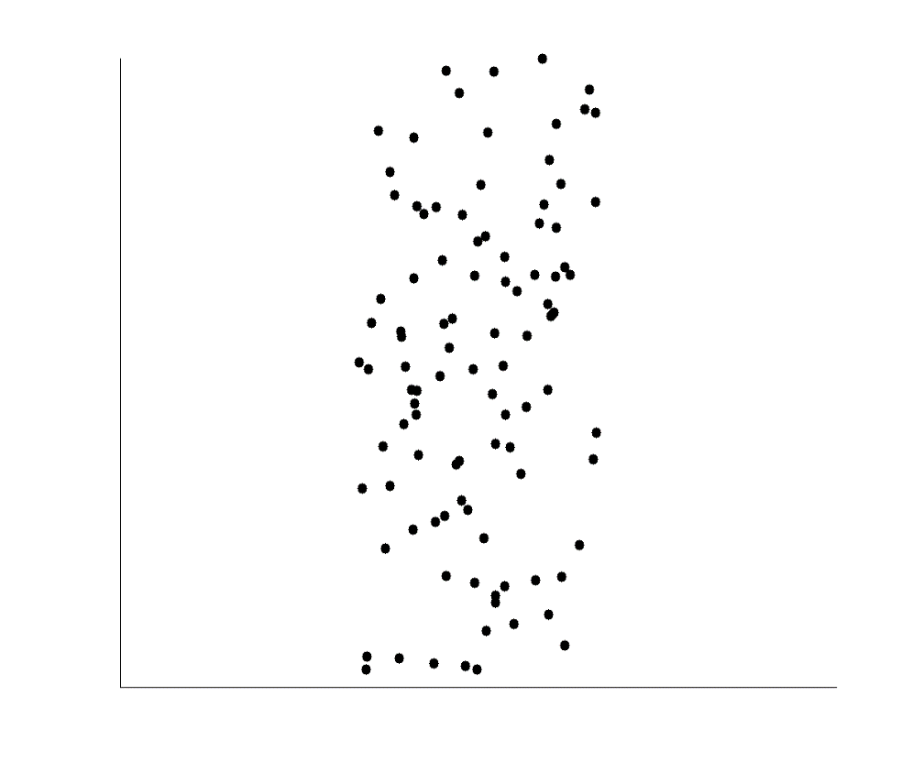
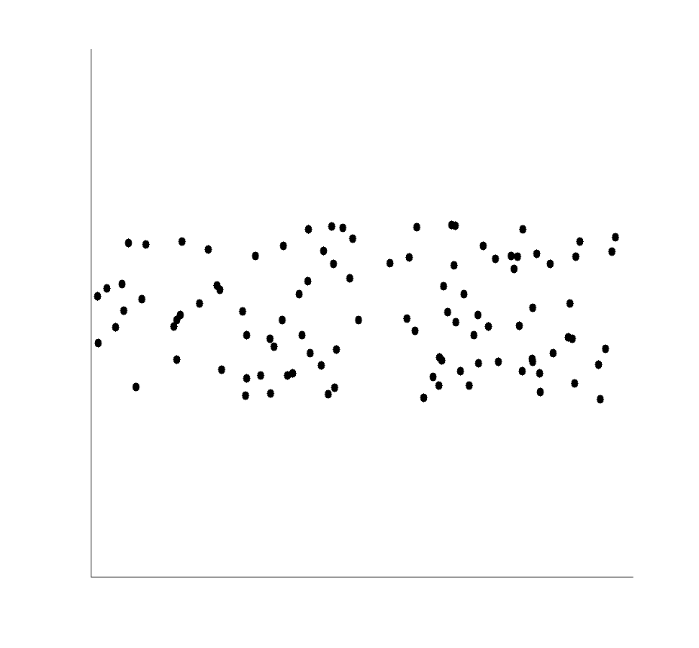
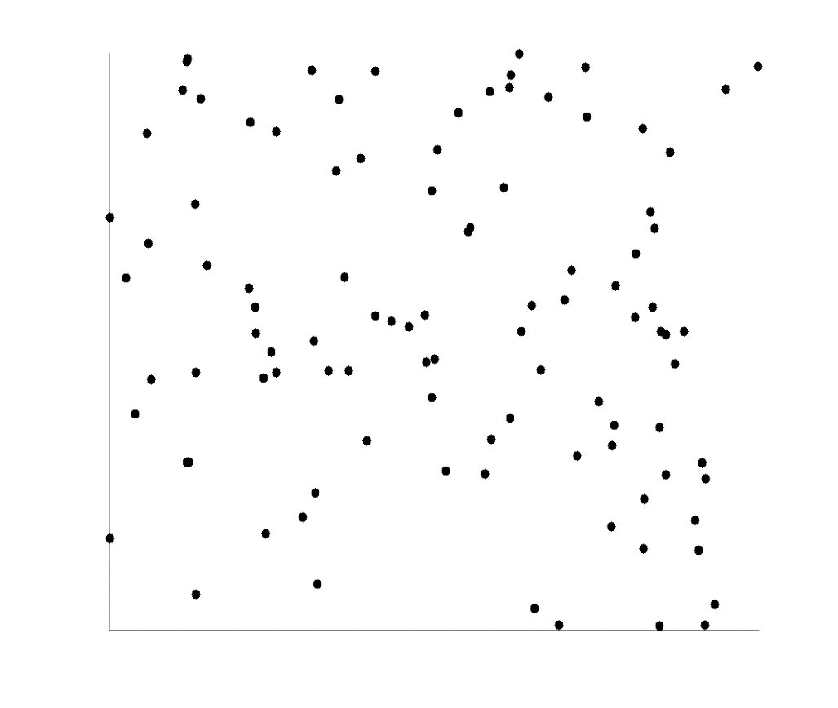
Uncorrelated Data

Slide 31
Measuring Data Similarity and Dissimilarity

Slide 32
Similarity and Dissimilarity
Similarity
Numerical measure of how alike two data objects are
Value is higher when objects are more alike
Often falls in the range [0,1]
Dissimilarity (e.g., distance)
Numerical measure of how different two data objects are
Lower when objects are more alike
Minimum dissimilarity is often 0
Proximity refers to a similarity or dissimilarity

Slide 33
Data Matrix and Dissimilarity Matrix
Data matrix
n data points with p dimensions
Dissimilarity matrix
n data points, but registers only the distance
A triangular matrix

Slide 34
1.Nominal Attributes
Can take 2 or more states, e.g., red, yellow, blue, green (generalization of a binary attribute)
Simple matching
m: # of matches, p: total # of variables

Slide 35
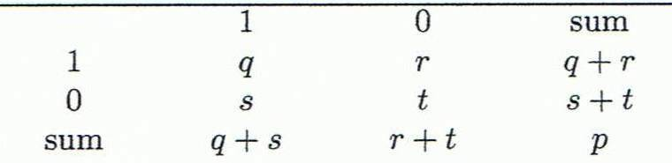
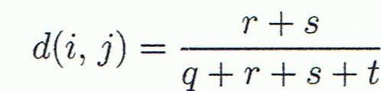
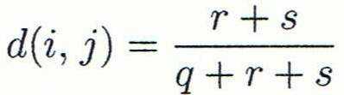
2. Binary Attributes
A contingency table for binary data
Distance measure for symmetric binary variables:
Distance measure for asymmetric binary variables:
Object j
Object i

Slide 36
Dissimilarity between Binary Variables
Example
Gender is a symmetric attribute
The remaining attributes are asymmetric binary
Let the values Y and P be 1, and the value N 0

Slide 37
3. Ordinal Attributes
An ordinal variable can be discrete or continuous
Order is important, e.g., rank
Can be treated like interval-scaled
replace x_{if} by their rank
map the range of each variable onto [0, 1] by replacing i-th object in the f-th variable by
compute the dissimilarity using methods for interval-scaled variables

Slide 38
4. Numeric Attributes
Minkowski distance: A popular distance measure
where i = (x_{i1}, x_{i2}, …, x_{ip}) and j = (x_{j1}, x_{j2}, …, x_{jp}) are two p-dimensional data objects, and h is the order (the distance so defined is also called L-h norm)
Properties
d(i, j) > 0 if i ≠ j, and d(i, i) = 0 (Positive definiteness)
d(i, j) = d(j, i) (Symmetry)
d(i, j) ≤ d(i, k) + d(k, j) (Triangle Inequality)
A distance that satisfies these properties is a metric

Slide 39
Special Cases of Minkowski Distance
h = 1: Manhattan (city block, L₁ norm) distance
E.g., the Hamming distance: the number of bits that are different between two binary vectors
h = 2: (L₂ norm) Euclidean distance
h → ∞. “supremum” (L_{max} norm, L∞ norm) distance.
This is the maximum difference between any component (attribute) of the vectors

Slide 40
Example: Minkowski Distance
Manhattan (L₁)
Euclidean (L₂)
Supremum

Slide 41
Attributes of Mixed Type
A database may contain all attribute types
Nominal, symmetric binary, asymmetric binary, numeric, ordinal
One may use a weighted formula to combine their effects
f is binary or nominal:
d_{ij}^{(f)} = 0 if x_{if} = x_{jf} , or d_{ij}^{(f)} = 1 otherwise
f is numeric: use the normalized distance
f is ordinal
Compute ranks r_{if} and
Treat z_{if} as interval-scaled

Slide 42
Standardizing Numeric Data
Z-score:
X: raw score to be standardized, μ: mean of the population, σ: standard deviation
the distance between the raw score and the population mean in units of the standard deviation
negative when the raw score is below the mean, “+” when above
An alternative way: Calculate the mean absolute deviation
where
standardized measure (z-score):
Using mean absolute deviation is more robust than using standard deviation

Slide 43
Example

Slide 44
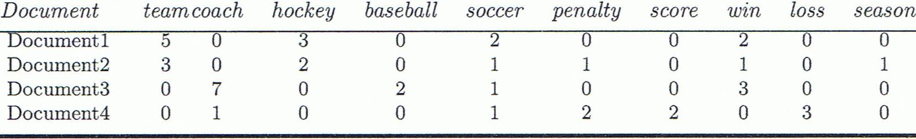
Cosine Similarity
A document can be represented by thousands of attributes, each recording the frequency of a particular word (such as keywords) or phrase in the document.
Applications: information retrieval, biologic taxonomy, gene feature mapping, ...
Cosine measure: If d₁ and d₂ are two vectors (e.g., term-frequency vectors), then
cos(d₁, d₂) = (d₁ • d₂) /||d₁|| ||d₂|| ,
where • indicates vector dot product, ||d||: the length of vector d

Slide 45
Example: Cosine Similarity
cos(d₁, d₂) = (d₁ • d₂) /||d₁|| ||d₂|| ,
where • indicates vector dot product, ||d|: the length of vector d
Ex: Find the similarity between documents 1 and 2.
d₁ = (5, 0, 3, 0, 2, 0, 0, 2, 0, 0)
d₂ = (3, 0, 2, 0, 1, 1, 0, 1, 0, 1)
d₁•d₂ = 5*3+0*0+3*2+0*0+2*1+0*1+0*1+2*1+0*0+0*1 = 25
||d₁||= (5*5+0*0+3*3+0*0+2*2+0*0+0*0+2*2+0*0+0*0)^{0.5}=(42)^{0.5} = 6.481
||d₂||= (3*3+0*0+2*2+0*0+1*1+1*1+0*0+1*1+0*0+1*1)^{0.5}=(17)^{0.5} = 4.12
cos(d₁, d₂ ) = 0.94

Slide 46
Data
Visualization

Slide 47
Data Visualization
Why data visualization?
Gain insight into an information space by mapping data onto graphical primitives
Provide qualitative overview of large data sets
Search for patterns, trends, structure, irregularities, relationships among data
Help find interesting regions and suitable parameters for further quantitative analysis
Categorization of visualization methods:
Pixel-oriented
Geometric projection
Icon-based
Hierarchical
Visualizing complex data and relations

Slide 48
1. Pixel-Oriented Visualization
For a data set of m dimensions, create m windows on the screen, one for each dimension
The m dimension values of a record are mapped to m pixels at the corresponding positions in the windows
The colors of the pixels reflect the corresponding values
Income
(b) Credit Limit
(c) transaction volume
(d) age
48
Notes:
48

Slide 49
1. Pixel-Oriented: Laying Out Pixels in Circle Segments
To save space and show the connections among multiple dimensions, space filling is often done in a circle segment
49
Notes:
49

Slide 50
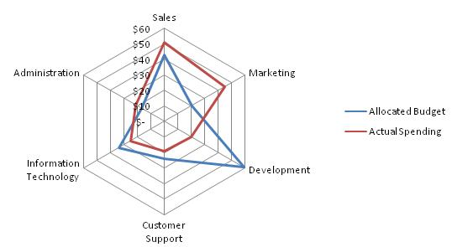
Pixel-Oriented: Radar Diagram

Slide 51
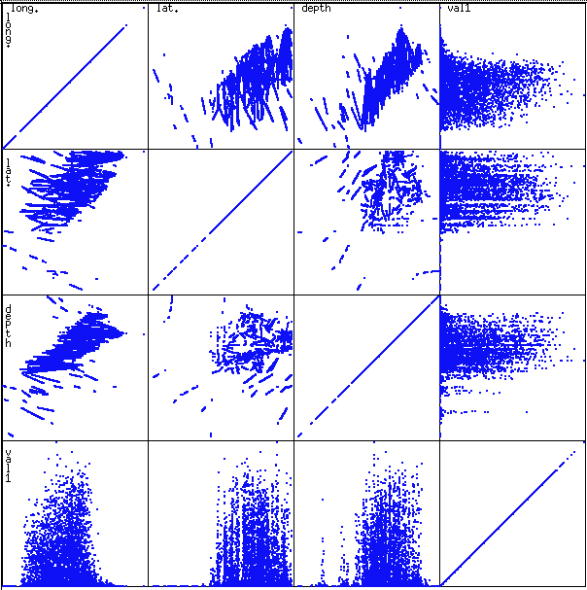
2. Geometric Projection: Scatterplot Matrices
Used by ermission of M. Ward, Worcester Polytechnic Institute

Slide 52
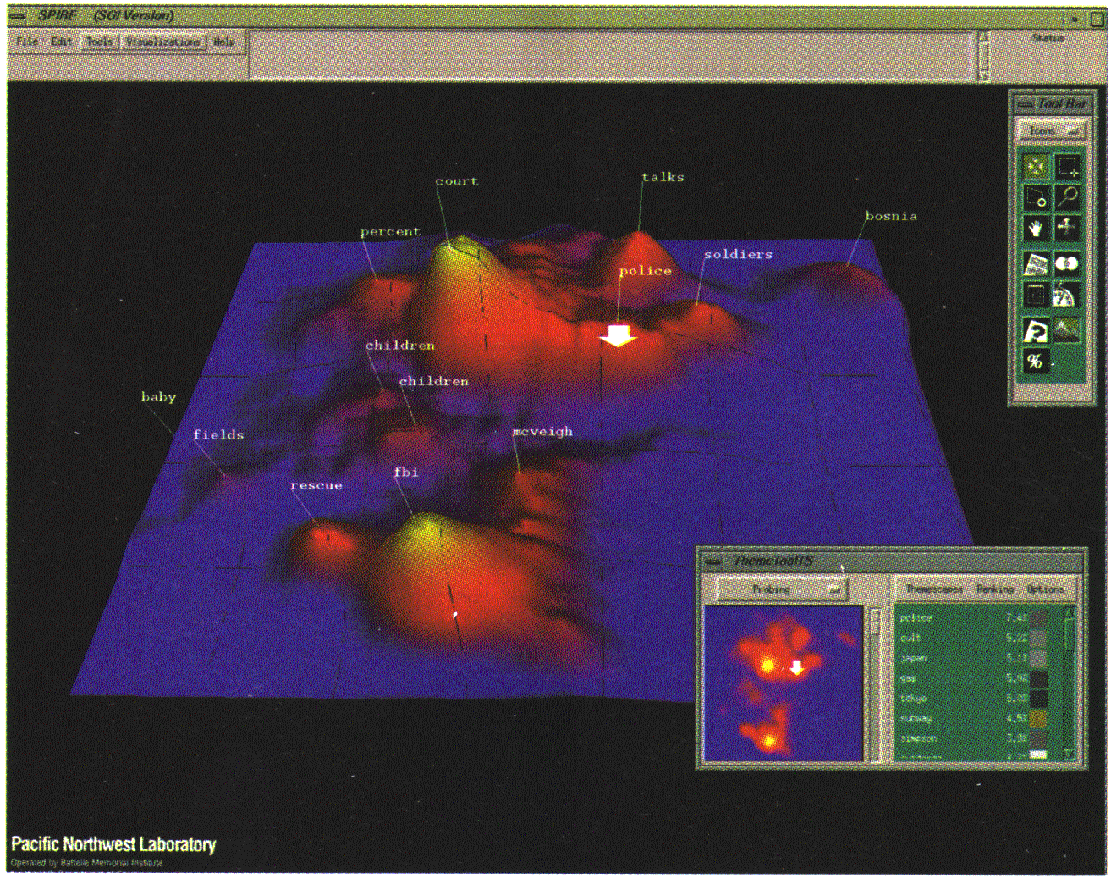
2. Geometric Projection: Landscapes
Used by permission of B. Wright, Visible Decisions Inc.

Slide 53
2. Geometric Projection: Parallel Coordinates
The axes are scaled to the [minimum, maximum]: range of the corresponding attribute

Slide 54
3. Icon-Based Visualization
Visualization of the data values as features of icons
Chernoff Faces
General techniques
Shape coding: Use shape to represent certain information encoding
Color icons: Use color icons to encode more information

Slide 55
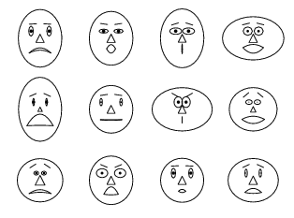
3. Icon-Based: Chernoff Faces
A way to display variables on a two-dimensional surface
e.g., let x be eyebrow slant, y be eye size, z be nose length, etc.
The figure shows faces produced using 10 characteristics

Slide 56
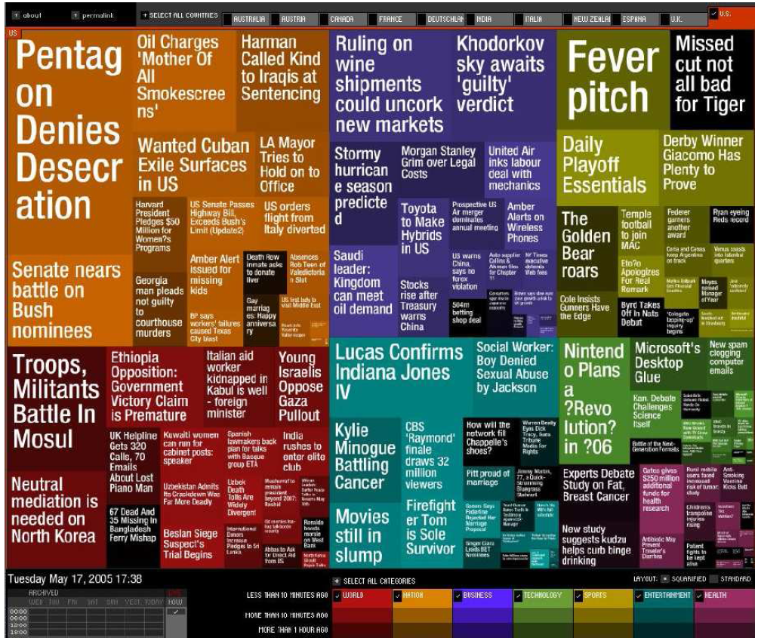
4. Hierarchical Visualization
Visualizing non-numerical data: text and social networks
The importance of tag is represented by font size/color
Newsmap:
Google News Stories
in 2005

Slide 57
5. Visualizing Complex Data and Relations
Visualizing popular tags using Tag cloud

Slide 58
5. Visualizing Complex Data and Relations
Disease influence graph

Slide 59
Summary
Data attribute types: nominal, binary, ordinal, interval-scaled, ratio-scaled
Many types of data sets, e.g., numerical, text, graph, Web, image.
Gain insight into the data by:
Basic statistical data description: central tendency, dispersion, graphical displays
Measure data similarity
Data visualization: map data onto graphical primitives
Above steps are the beginning of data preprocessing.
Many methods have been developed but still an active area of research.

Slide 60


